Slide 1
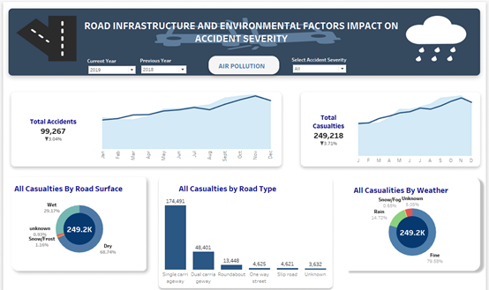
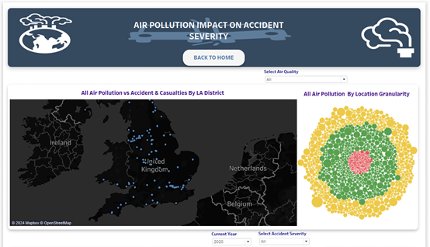




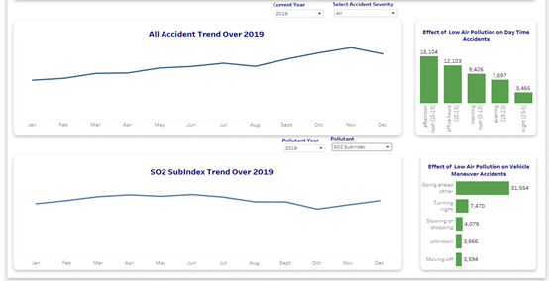


IMPACT OF ENVIRONMENTAL, ROAD INFRASTRUCTURE AND AIR QUALITY ON ACCIDENT SEVERITY IN THE UK
ABAYOMI AKINMOLADUN
CORRELATION <> CAUSATION
JUST AN INSIGHT TO DIG DEEPER
If prompt and rapid attention is not given to this up-rising menace casualties from road safety negligence are forecasted to lead to an increase of about 1.2 million deaths around the world yearly (Ramos et al., 2015). According to the latest report by the World Health Organization (WHO), traffic accidents claim the lives of about 1.19 million people every year, with highway accidents often causing more severe injuries Between 20 and 50 million people suffer non-fatal injuries in road traffic accidents and more than half of all fatalities are helpless road users such as pedestrians, cyclists, and motorcyclists (Road safety, 2023).
Visual Analytics combines data analysis with interactive visualizations, simplifying knowledge discovery from complex data sets (Ramos et al., 2015). Visualizing road traffic accidents is an essential tool to improve road safety and aid decision-makers in understanding accident patterns and causes, which will help in making policies that will assist in safeguarding road users in the UK.
Food-4-Thought
Most of the recorded accident did not happen due to bad road infrastructure or weather condition. They all happened under the ideal and perfect situation
The Golden Age Group
People within the age band of 25 – 35 are less likely to get involved in road accident compared to every other age bracket, based on the result from ordinal logistic regression model.
The Best Drivers
Males are more likely to get involved in an accident compared to female based on the model used for inferential analysis.
Could Sulphur Dioxide SO2
and Ozone 03 be the Antagonists?
The trend line shows correlation between Accident and this pollutants, which are actually known to be dangerous to human well-being. Triangulating NHS data to this merged data could shed more insight.
Light at the end of Tunnel, The Protagonist.
Encouraging more Adoption of electric cars could help to reduce the effect of this pollutants on innocent UK road users. Based on the insight from the Tableau Dashboard.

